Slide 1
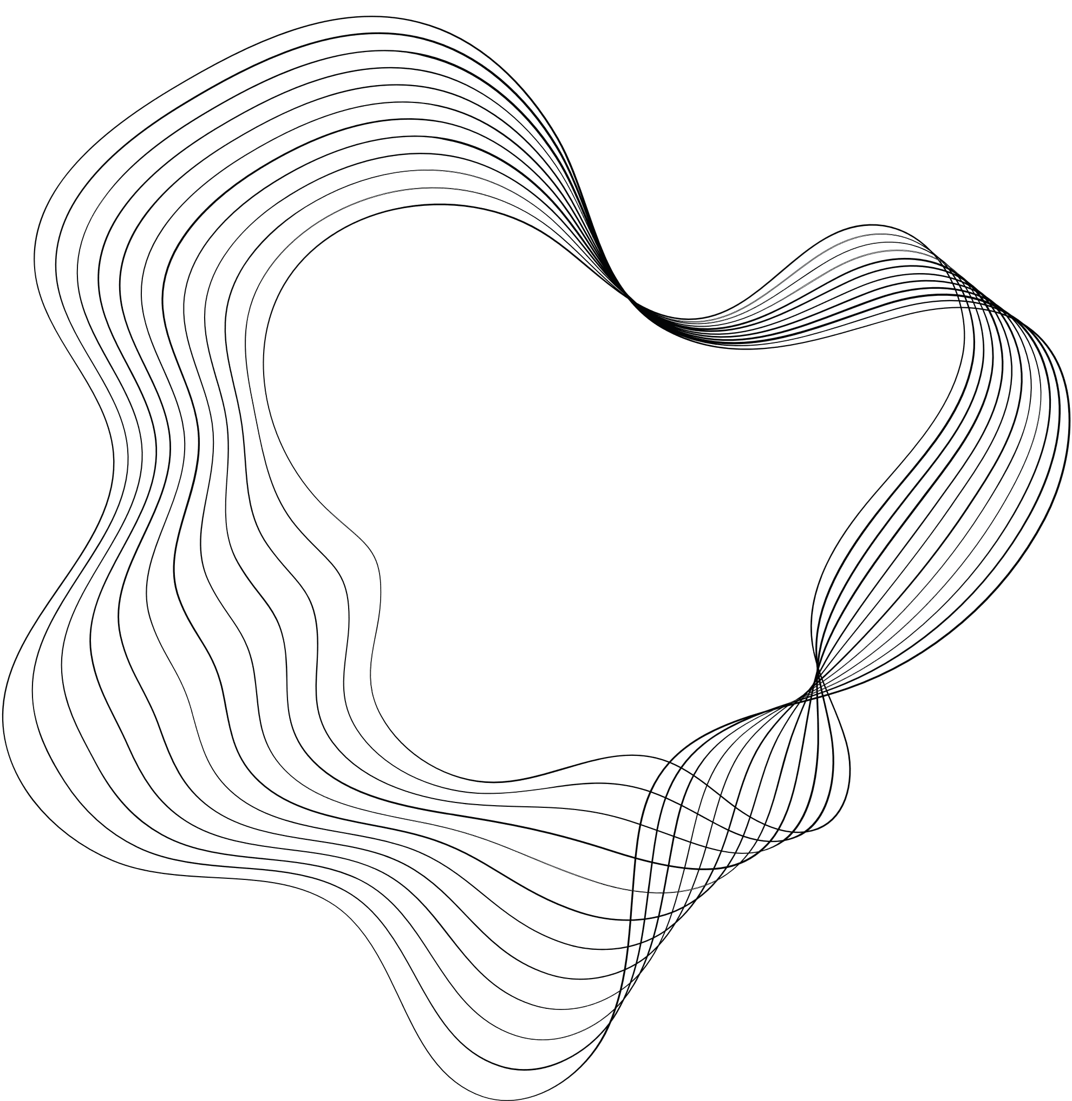

BANK CUSTOMER CHURN
PREDICTION
GROUP NUMBER-10
Presented By:
Bhagyashree Swain(C1-09)
Saurav Mohanty(C2-20)
Debasis Muduli(C2-30)
Sonali Sethi(C2-31)

Slide 2

PROBLEM STATEMENT
Customer churn happens when customers close their accounts or stop interacting with the bank.
Financial Impact: Leads to reduced sales, lower annual revenue, and potential market value loss.
Reputational Impact: Affects the bank's image and customer trust.
Traditional Methods:
Reactive(Banks only act after the customer has already left.)
Core Problem: Banks don’t have a way to predict which customers are likely to leave before it happens. This is where machine learning comes in. By identifying at-risk customers in advance, banks can take proactive steps to retain them.

Slide 3



Vision and Goal of the project
Build a Predictive Model: Develop a machine learning model to accurately classify customers at risk of churning.
Understand Churn Drivers: Analyze key factors influencing customer churn through data exploration and visualization.
The project aims to analyze customer churn behavior and build an effective predictive model to help businesses retain customers and reduce revenue loss.
This Project uncover patterns and factors that influence churn.
By leveraging data-driven insights and machine learning, the goal is to identify at-risk customers and recommend actionable strategies for retention.
Optimize Retention Strategies: Use insights from the model to recommend targeted actions for improving customer satisfaction and loyalty.

Slide 4


Solution Approach
01
02
03
04
05
Data Collection and Preparation
Feature Selection and Splitting
Model Development
Model Selection
Model Evaluation
Selected relevant features.
Split the data into train and test sets.
Clean the dataset, handle missing values, encode categorical variables, and scale numerical features.
Address class imbalance using techniques like SMOTE.
Train machine learning models like Logistic Regression, KNN, SVM, Decision Tree Random Forest.
Compare models based on validation metrics to identify the most promising one.
Assess the selected model on validation/test data using accuracy, precision, recall and F1-score.

Slide 5
Done with Data Preparation
Dataset Overview: 10,000 entries and 14 columns.
There were 3 Categorical features and 11 Numerical features.
Missing Values: Confirmed no null values in the dataset (df.isnull().sum()).
Data Cleaning
Identified irrelevant features such as: RowNumber, CustomerId, Surname.
Dropped columns to focus on relevant attributes.
Key Features
CreditScore, Geography, Gender, Age, Tenure, Balance, NumOfProducts, etc.
Target variable: Exited (indicates churn status).
Feature Engineering: Encode categorical variables like Geography and Gender.
Data Splitting: Prepared train-test sets.

Slide 6
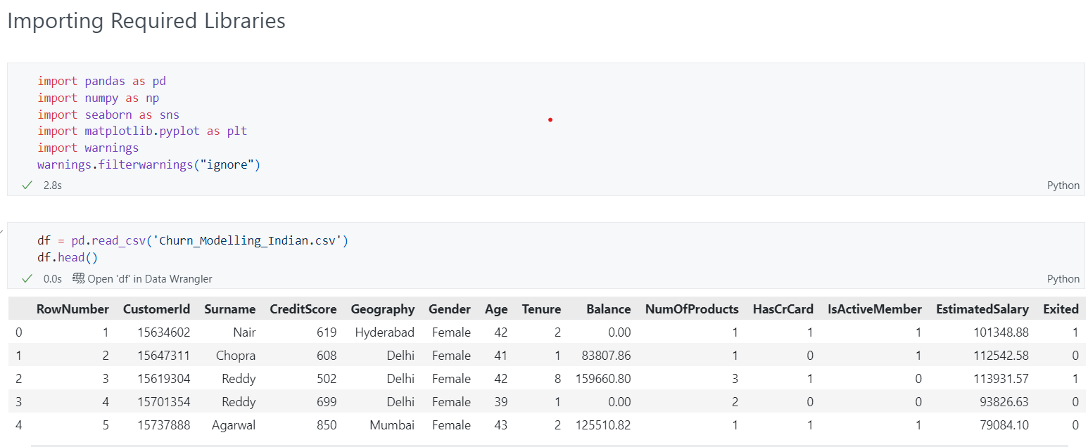

Slide 7
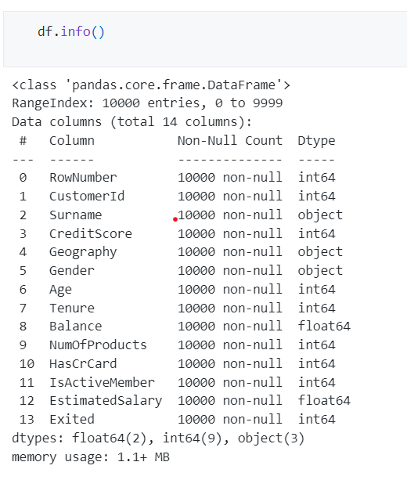
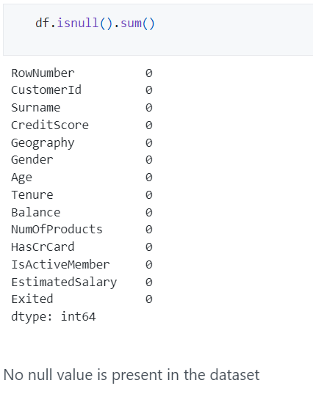

Slide 8
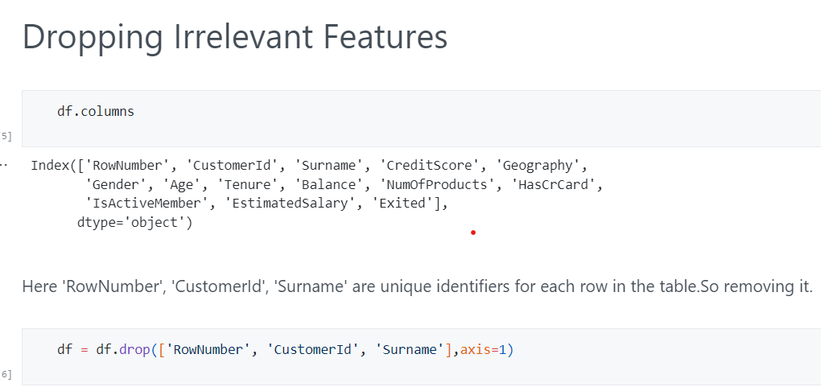

Slide 9
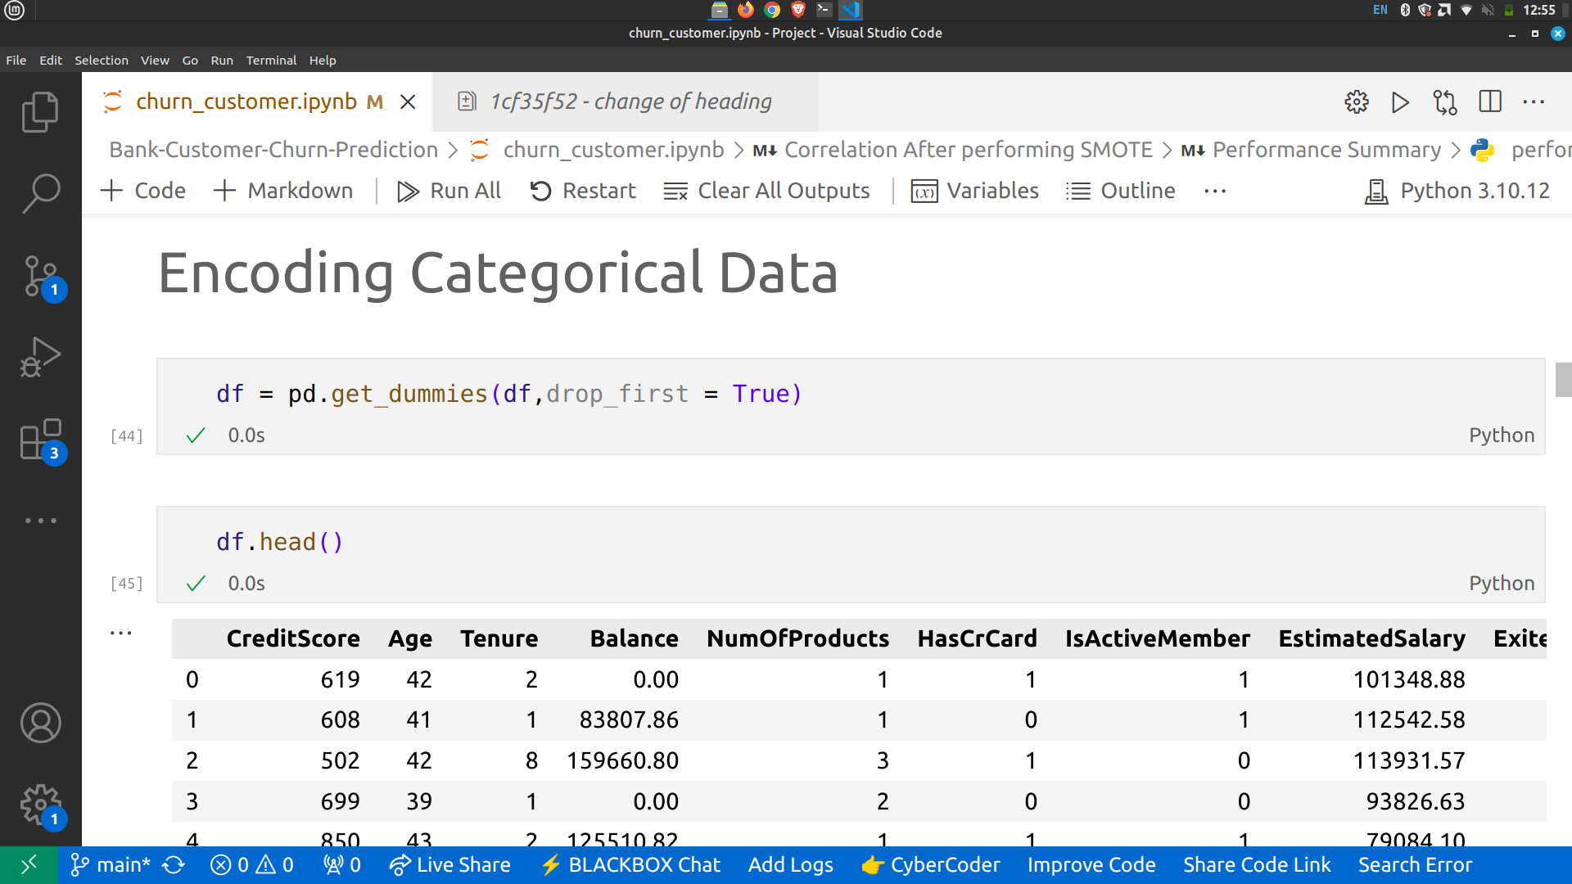
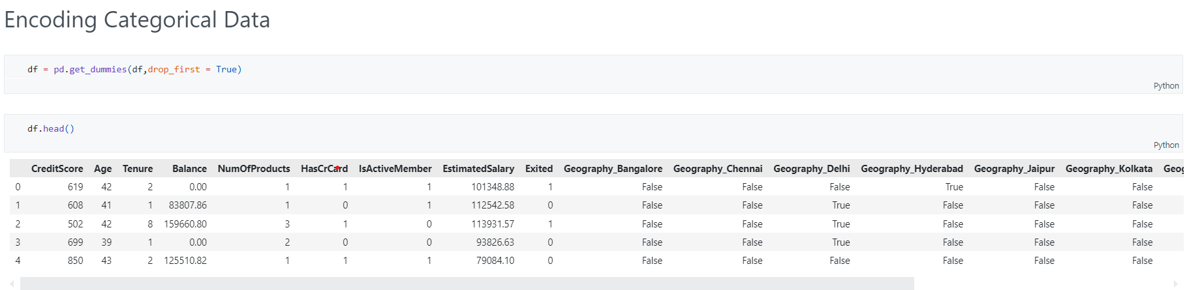
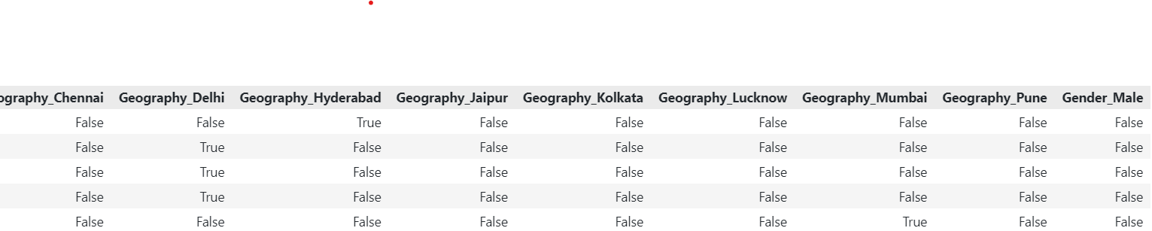

Slide 10
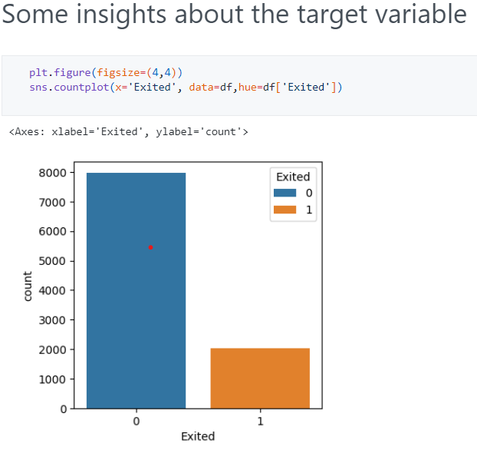
Data is highly imbalanced , with a large number of negative samples and a small number of positive samples.
This can lead to biased models that perform well on the majority class (negative samples) but poorly on the minority class (positive class).
To address this, we are using technique SMOTE for oversampling the minority class.

Slide 11
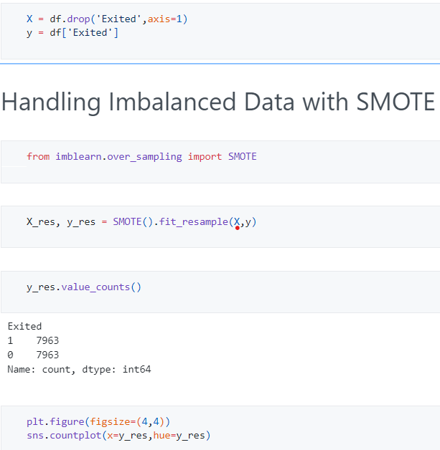
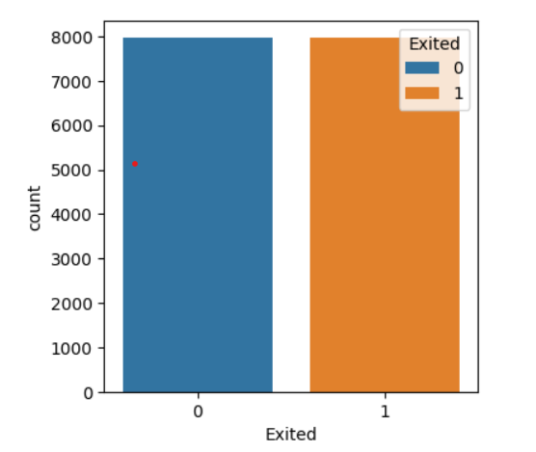

Slide 12
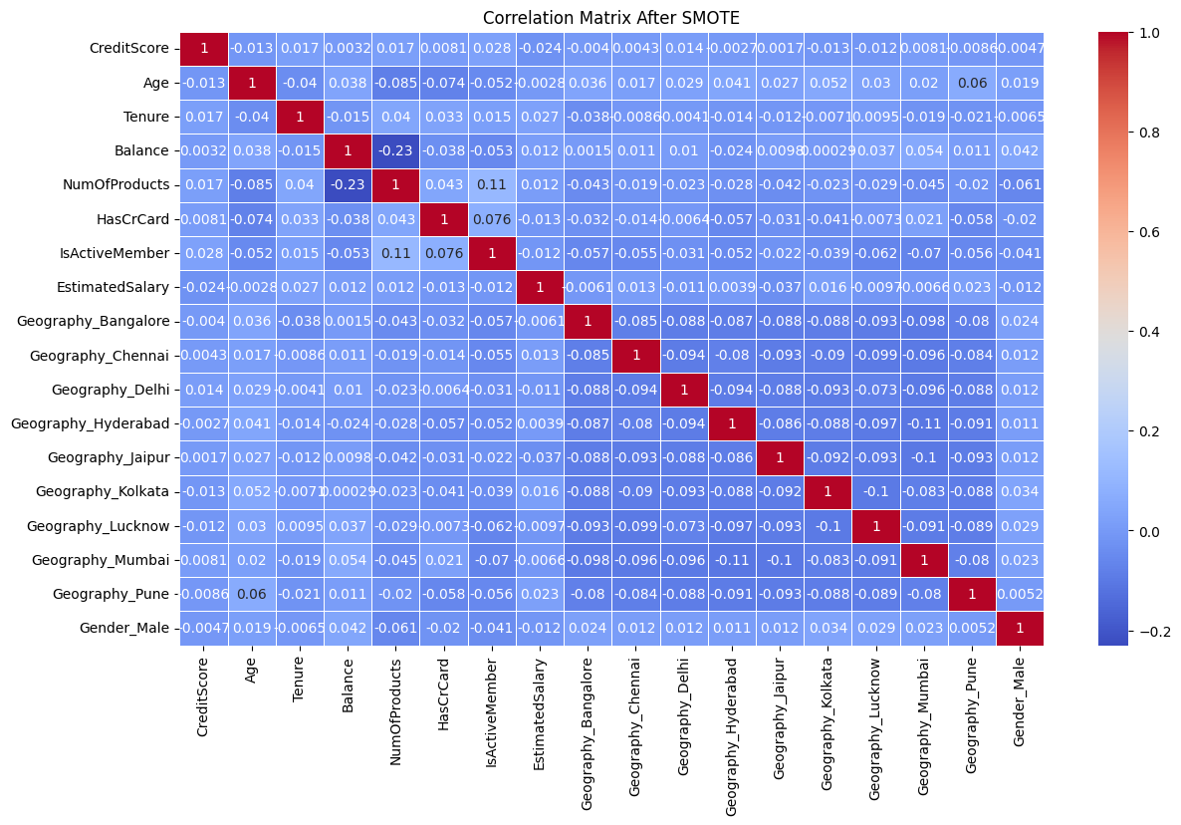

Slide 13
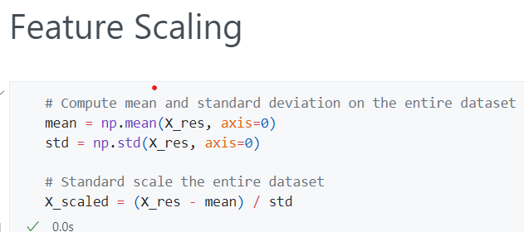
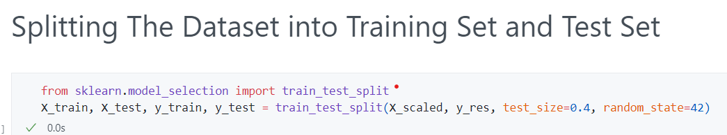

Slide 14
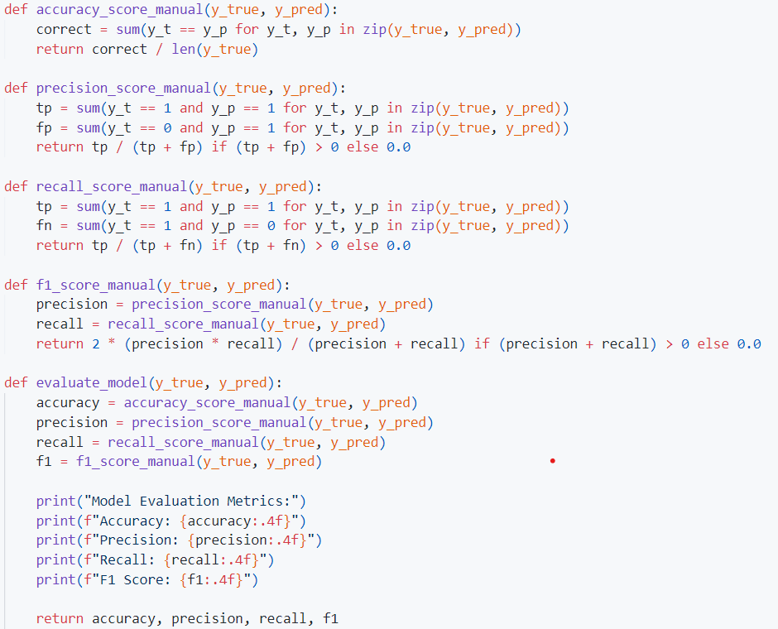

Slide 15
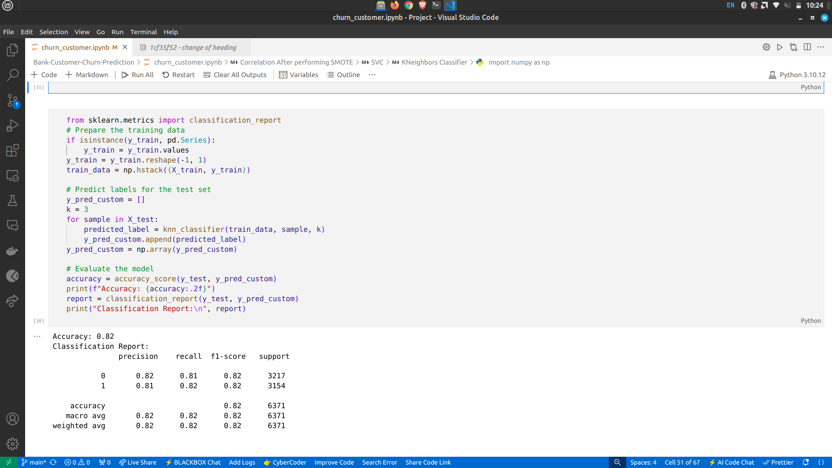
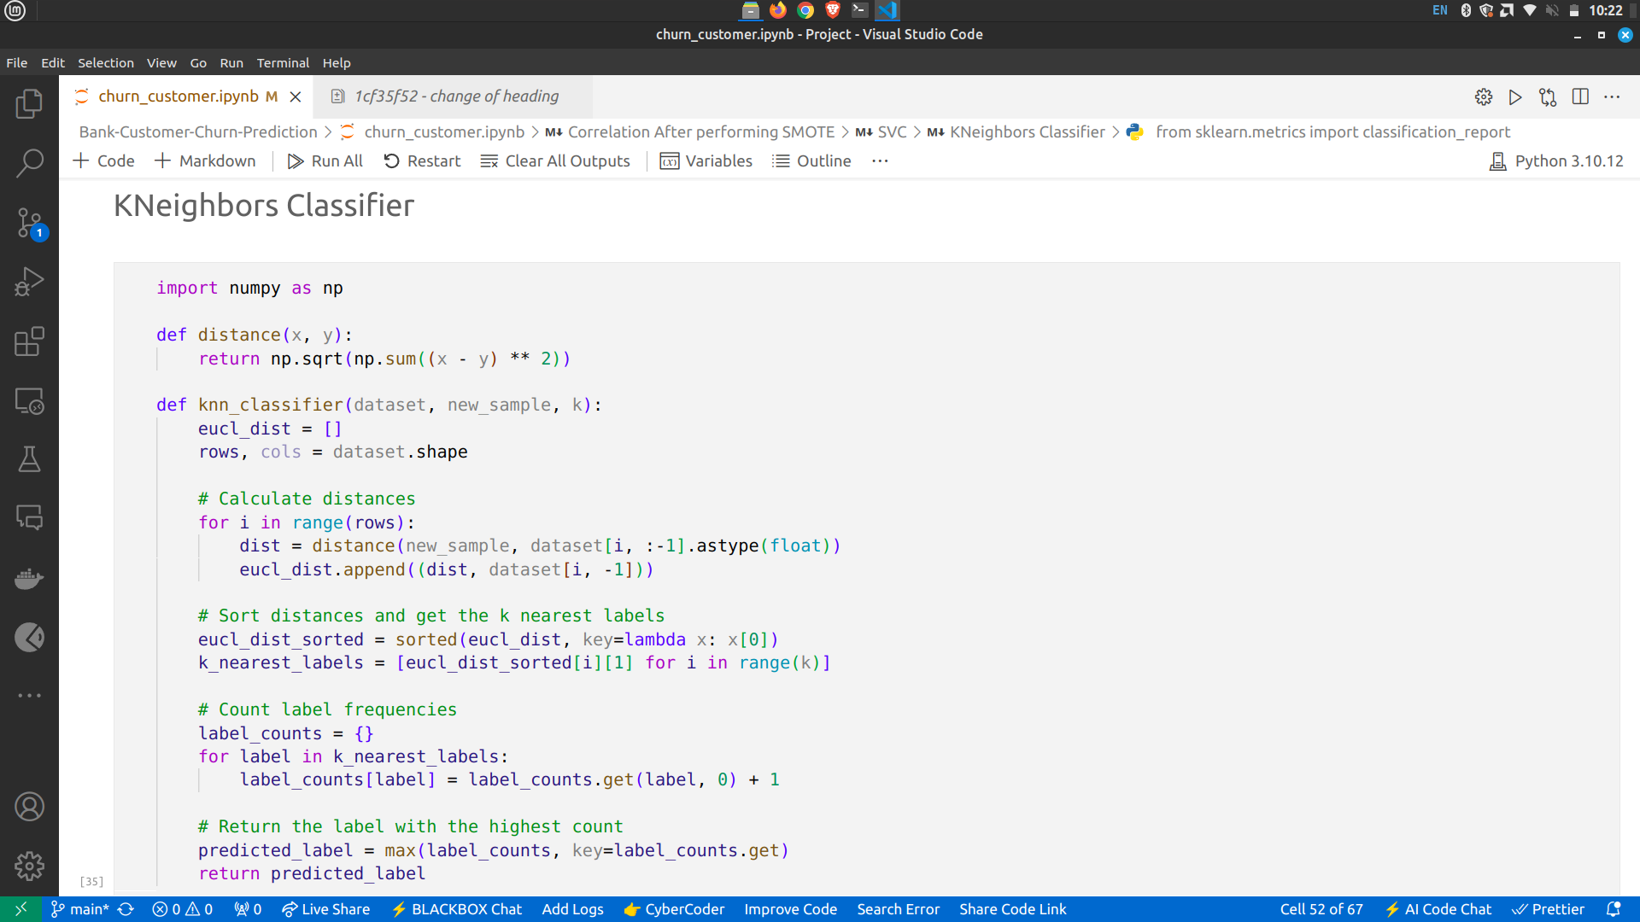

Slide 16
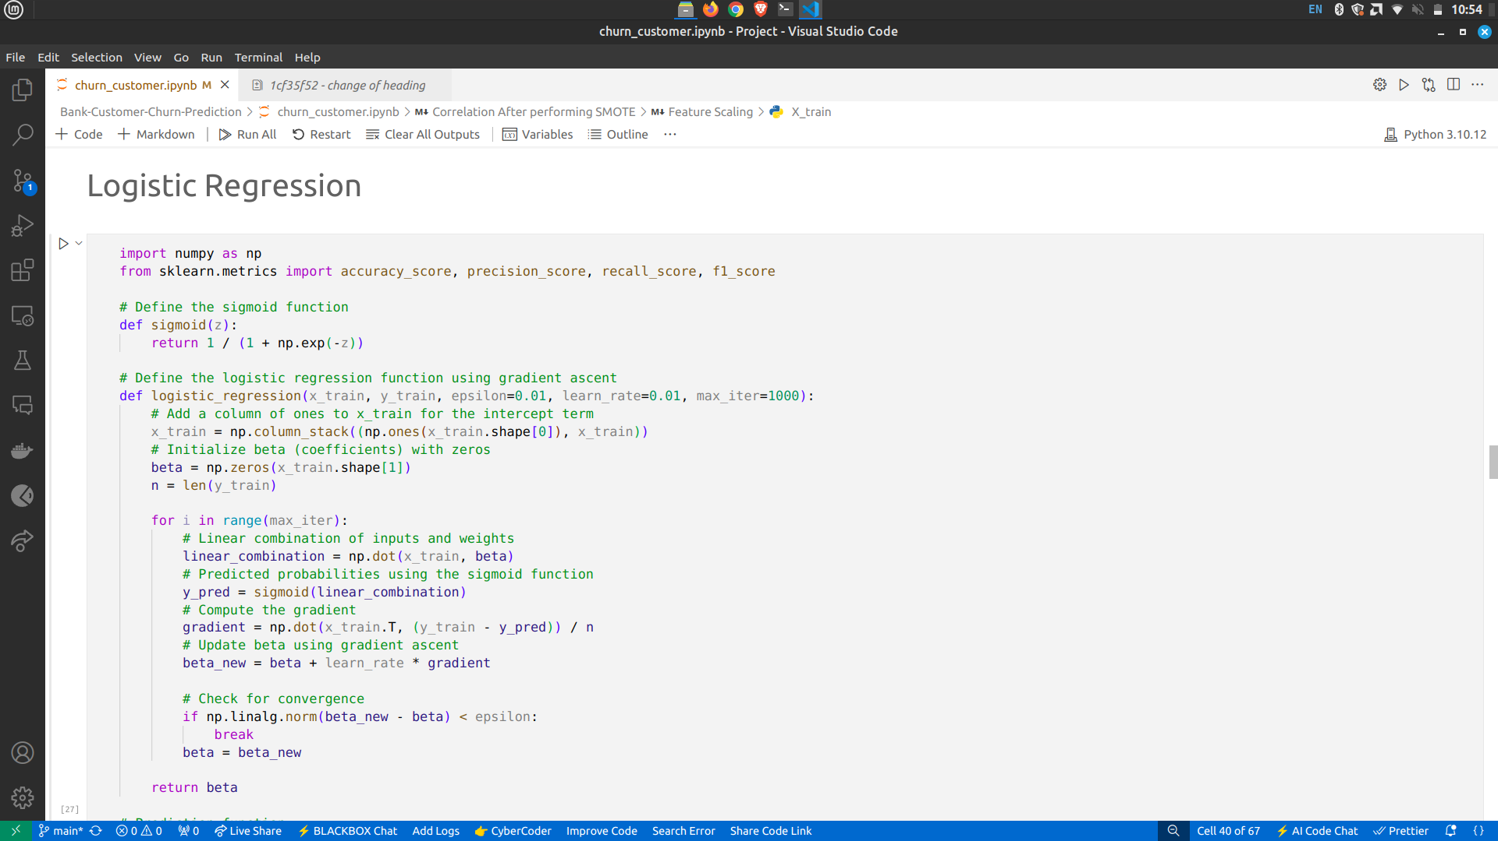
Logistic Regression:

Slide 17
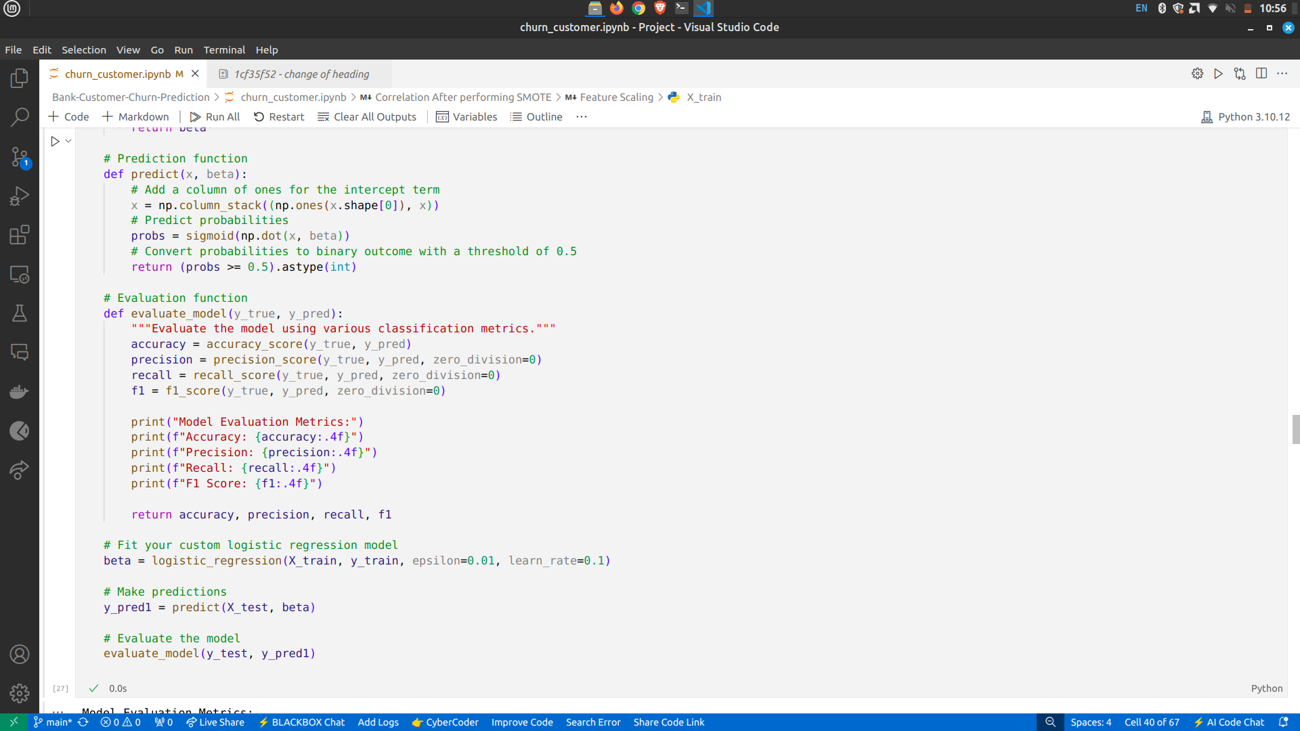
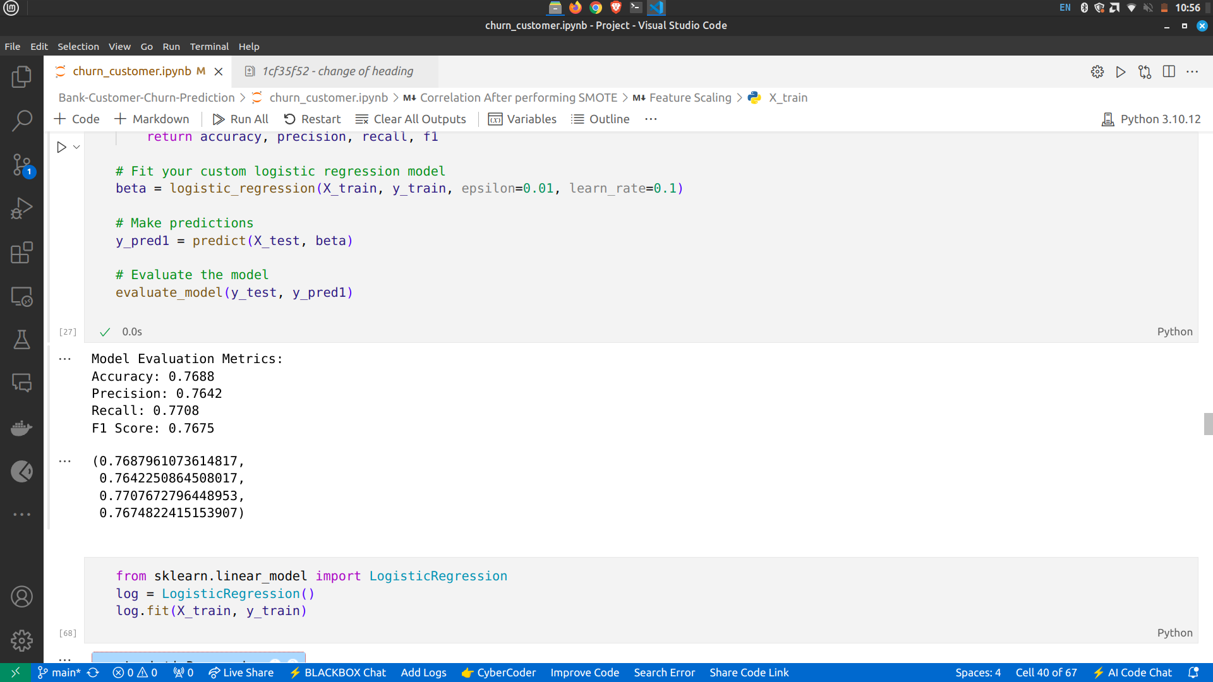

Slide 18
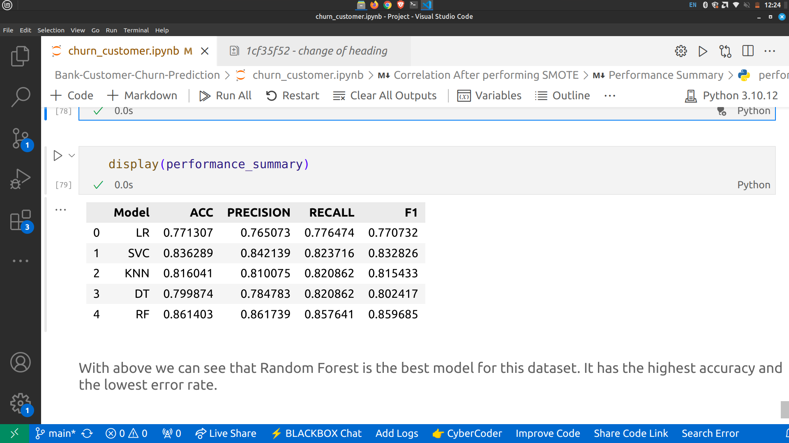
After all Steps Trained the data with 5 different algorithm
1.Logistic Regression
2.SVM
3.KNN
4.Desicion Tree
5.Random Forest
Performance Summary of all Above
With above we can see that Random Forest is the best model for this dataset. It has the highest accuracy and the lowest error rate.

Slide 19
CONCLUSION
The Random Forest algorithm emerged as the best model, achieving the highest accuracy and lowest error rate.
This model empowers banks to proactively identify at-risk customers, enabling timely retention strategies to reduce churn and sustain revenue.

Slide 20
REFERENCES
https://www.kaggle.com/datasets/amirmotefaker/churn-modeling-bank
https://www.analyticsvidhya.com/blog/2021/06/understanding-random-forest/
https://www.researchgate.net/publication/357539438_Customer_churn_analysis_in_banking_sector_Evidence_from_explainable_machine_learning_models

Slide 21
THANK YOU

